Slide 1
Unit 2

Slide 2
Bresenham Line Drawing Algorithm
Starting coordinates = (X0, Y0)
Ending coordinates = (Xn, Yn)
The points generation using Bresenham Line Drawing Algorithm involves the following steps-
Step-01:
Calculate ΔX and ΔY from the given input.
These parameters are calculated as-
ΔX = Xn – X0
ΔY =Yn – Y0

Slide 3
Step-02:
Calculate the decision parameter Pk.
It is calculated as-
Pk = 2ΔY – ΔX

Slide 4
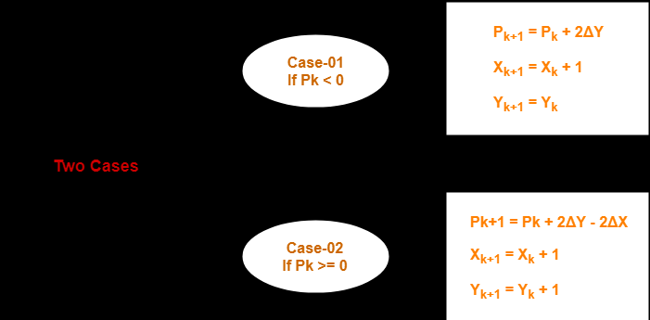
Step 03:

Slide 5
Step-04:
Keep repeating Step-03 until the end point is reached or number of iterations equals to (ΔX-1) times.

Slide 6
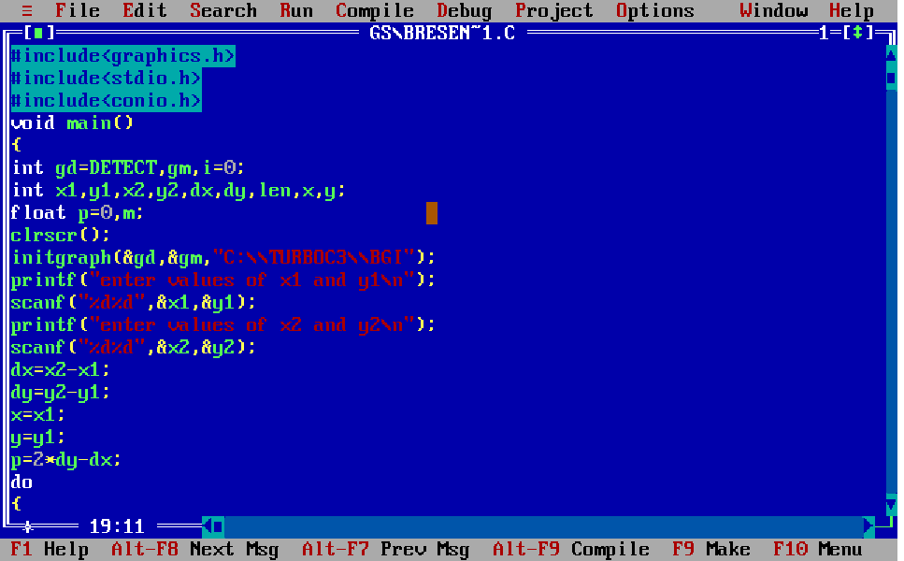

Slide 7
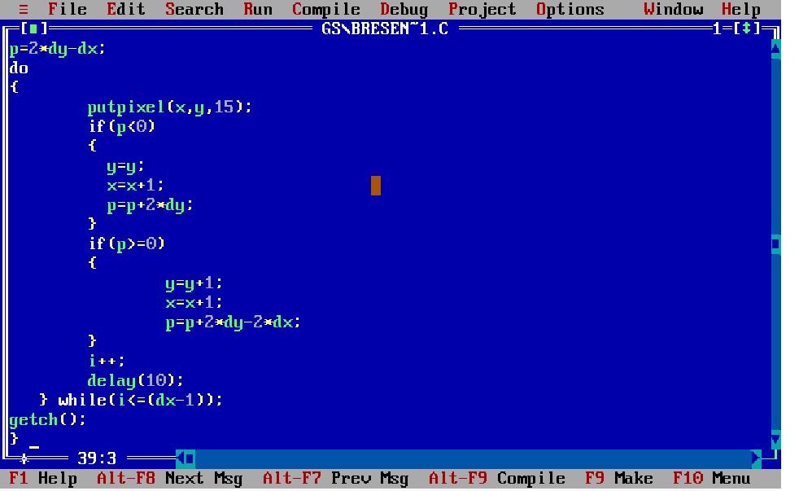

Slide 8
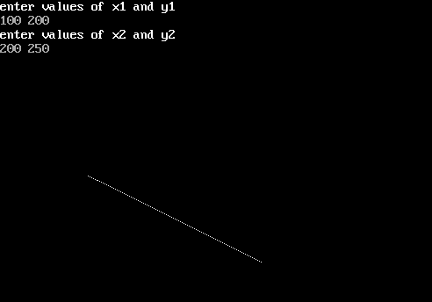
Output 1

Slide 9
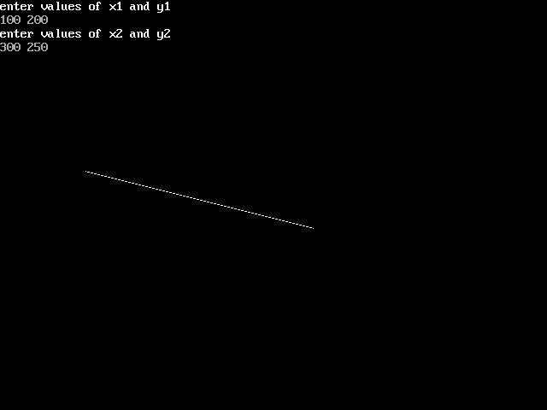
Output 2

Slide 10
Ref video link
https://youtu.be/RGB-wlatStc

